Slide 1
History of Management
Lecturer: Orla Gregory

Slide 2
Areas discussed include ….
Describing some early management examples.
Explaining the various theories in the classical approach.
Discussing the development and uses of the behavioral approach.
Describing the quantitative approach.
Explaining the various theories in the contemporary approach to management.

Slide 3
Video Links
History of Management (3.15 mins) http://www.youtube.com/watch?v=fF_YvY7jfiE
Ford & Scientific Management (7.23 mins)

Slide 4

Introduction
Since the birth of modern management theory in the early 1900s, management experts have developed theories to help organisations and their managers coordinate and oversee work activities as effectively and efficiently as possible.
In reviewing the history of modern management, it is possible to explore the evolution of management thought and practice during the twentieth century.
By having a knowledge of management history, it can help us better understand current management practices while avoiding some mistakes of the past.

Slide 5


Historical Background of Management
Organisations and managers have existed for thousands of years.
The Egyptian Pyramids and the Great Wall of China were projects of tremendous scope and magnitude, requiring the efforts of tens of thousands of people.
How was it possible for these projects to be completed successfully?
The answer is MANAGEMENT!
Regardless of the titles given to managers throughout history, someone has always had to plan what needs to be accomplished, organise people and materials, lead and direct workers, and impose controls to ensure that goals were attained as planned.

Slide 6

Historical Background of Management
Examples of early management practices can also be seen by studying the Arsenal of Venice.
The Venetian Arsenal was a complex of state owned shipyards and armories, clustered together in the Republic of Venice.
It was responsible for the bulk of Venice's naval power during the middle part of the second millennium AD.
It was one of the earliest large-scale industrial enterprises in history.
Assembly lines, accounting systems, and personnel functions are only a few of the processes and activities used in business in the fifteenth century that are common to today’s organisations as well.

Slide 7
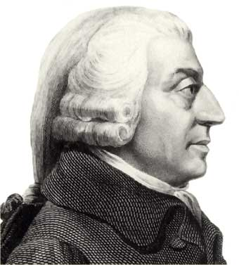
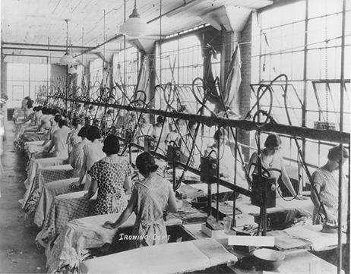
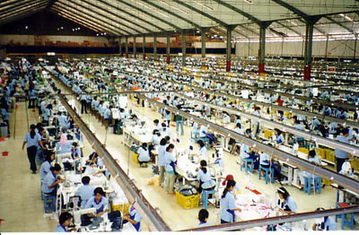
Historical Background of Management
Adam Smith, author of the classical economics doctrine The Wealth of Nations.
He argued brilliantly for the economic advantages that he believed division of labor (the breakdown of jobs into narrow, repetitive tasks) would bring to organisations and society.

Slide 8

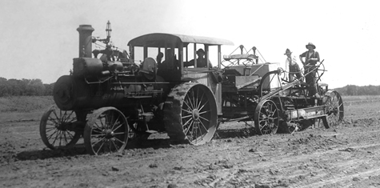
Historical Background of Management
The Industrial Revolution is possibly the most important pre-twentieth-century influence on management.
Substituted machine power for human labor
Created large organisations in need of management
The introduction of machine powers combined with the division of labor made large, efficient factories possible. Planning, organising, leading, and controlling became necessary activities.

Slide 9
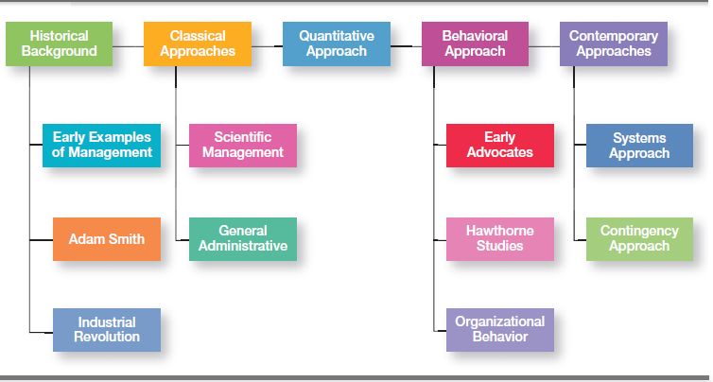
Four Major Approaches to Management (Source: Robbins & Coulter, 2014)

Slide 10
Classical Approach
The first studies of management, often called the classical approach, emphasised rationality and making organisations and workers as efficient as possible.
Two major theories;
(1) Scientific Management
The two most important contributors to scientific management theory were Frederick W. Taylor and the husband-wife team of Frank and Lillian Gilbreth
(2) General Administrative Theory
The two most important contributors to general administrative theory were Henri Fayol and Max Weber.

Slide 11
Scientific Management
The theory of Scientific Management
Using scientific methods to define the “one best way” for a job to be done:
Putting the right person on the job with the correct tools and equipment,
Having a standardised method of doing the job,
Providing an economic incentive to the worker.
It is said modern management theory was ‘born’ in 1911, when Taylor’s Principles of Scientific Management was published.

Slide 12
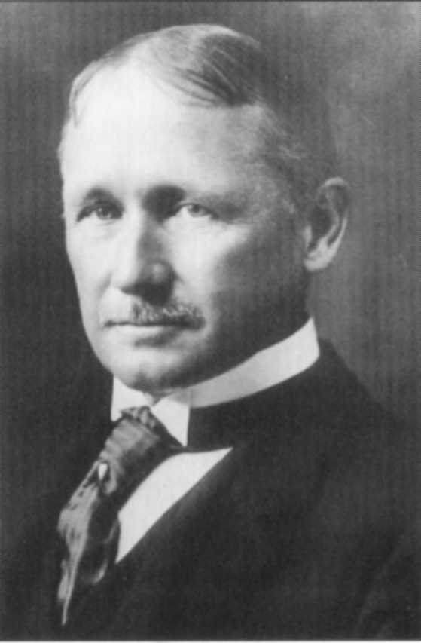
Scientific Management
Frederick W. Taylor is known as the “father” of scientific management.
Taylor’s work at the Midvale and Bethlehem Steel companies stimulated his interest in improving efficiency.
Taylor sought to create a mental revolution among both workers and managers by defining clear guidelines for improving production efficiency.
He defined four principles of management (see next slide)
His pig iron experiment is probably the most widely cited example of his scientific management efforts.
Frederick W. Taylor achieved consistent improvements in productivity in the range of 200 percent.
He affirmed the role of managers to plan and control and the role of workers to perform as they were instructed.

Slide 13
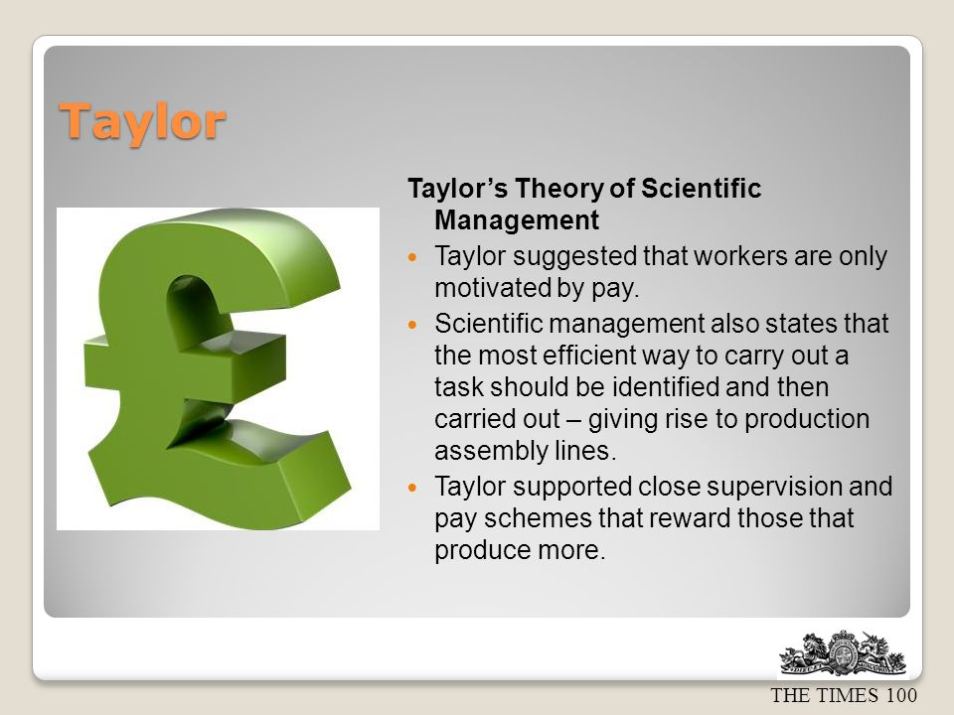

Slide 14
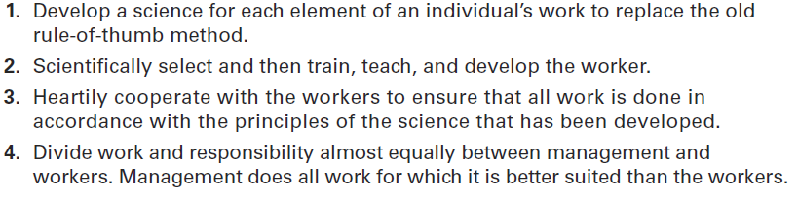
Taylor’s Scientific Management Principles

Slide 15
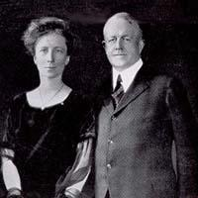
Frank and Lillian Gilbreth
Frank Gilbreth and his wife Lillian (a psychologist) Gilbreth were inspired by Taylor’s work and proceeded to study and develop their own methods of scientific management.
Frank Gilbreth is probably best known for his experiments in reducing the number inefficient hand-and-body of motions in bricklaying.
The Gilbreths were among the first to use motion picture films to study hand-and-body motions in order to eliminate wasteful motions.
They also devised a classification scheme to label 17 basic hand motions (such as search, grasp, hold) called ‘Therbligs’ (Gilbreth spelled backward, with the th transposed).

Slide 16
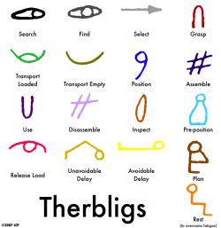

Slide 17

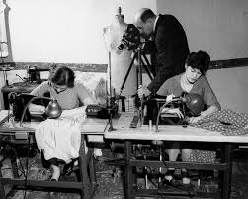
Time & Motion Studies

Slide 18
How Do Today’s Managers Use Scientific Management?
Guidelines devised by Taylor and others to improve production efficiency are still used in today’s organisations.
However, current management practice is not restricted to scientific management practices alone.
Elements of scientific management still used include:
Using time and motion studies,
Hiring best qualified workers,
Designing incentive systems based on output.

Slide 19
General Administrative Theory
General Administrative Theory - an approach to management that focuses on the entire organisation, and describing what managers do and what constitutes good management practice.
Henri Fayol
Max Weber

Slide 20
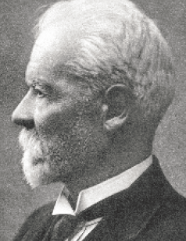
General Administrative Theory: Henri Fayol
Henri Fayol, who was a contemporary of Frederick W. Taylor, was the managing director of a large French coal-mining firm.
Believed that the practice of management was distinct from other organisational functions.
…distinct from accounting, finance, production, distribution, and other typical business functions.
His belief that management was a activity common to all business endeavors, government, and even the home, led him to develop 14 principles of management;
fundamental rules of management that could be applied to all organisational situations and taught in schools.

Slide 21
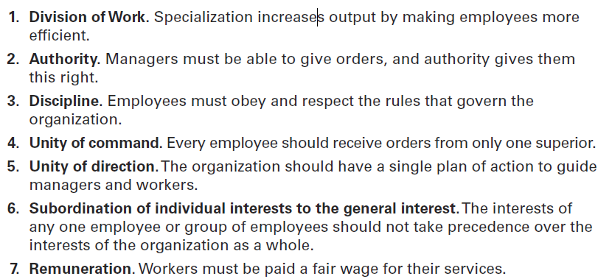
Fayol’s 14 Principles of Management

Slide 22
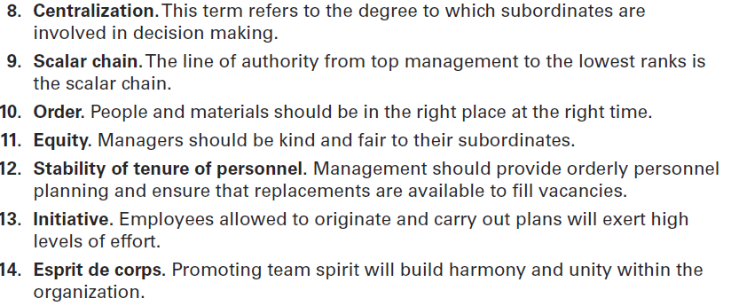
Fayol’s 14 Principles of Management

Slide 23
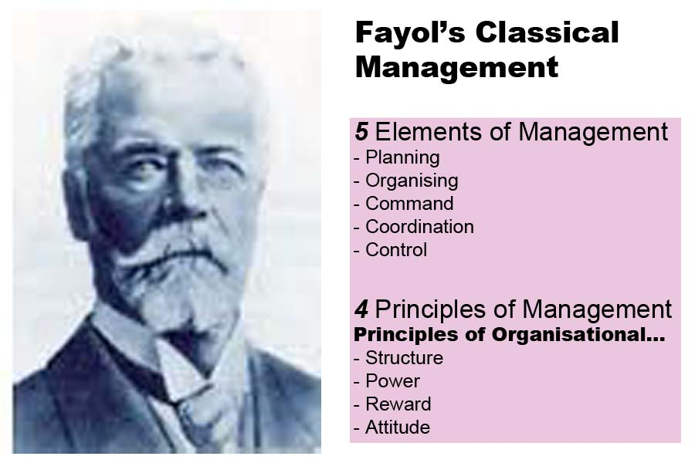

Slide 24
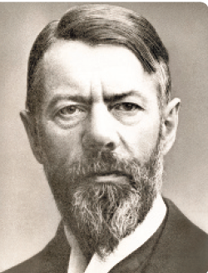
General Administrative Theory – Max Weber
Max Weber(pronounced VAY-ber)
Weber was a German sociologist who studied organisations.
Writing in the early 1900s, he developed a theory of authority based on an ideal type of organisation he called a bureaucracy - a form of organisation characterised by division of labor, a clearly defined hierarchy, detailed rules and regulations, and impersonal relationships.
Emphasised rationality, predictability, impersonality, technical competence, and authoritarianism

Slide 25
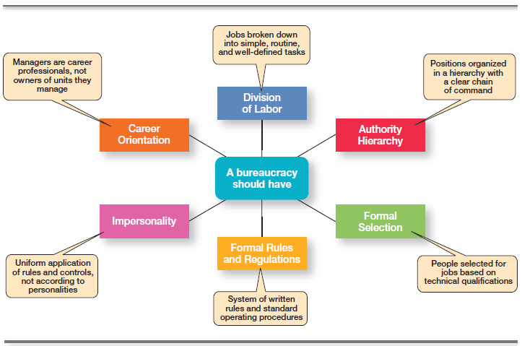
Characteristics of Weber’s Bureaucracy

Slide 26
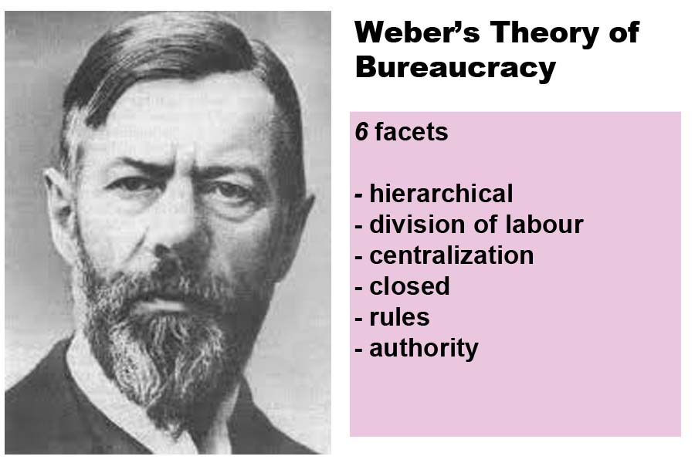

Slide 27
How Do Today’s Managers Use General Administrative Theories?
Some current management concepts and theories can be traced to the work of the general administrative theorists.
The functional view of a manager’s job relates to Henri Fayol’s concept of management.
Weber’s bureaucratic characteristics are evident in many of today’s large organisations - even in highly flexible organisations that employ talented professionals.
Some bureaucratic mechanisms are necessary in highly innovative organisations to ensure that resources are used efficiently and effectively.

Slide 28

Organisational Behavior
The field of study concerned with the actions (behaviors) of people at work is organisational behavior.
Organisational behavior (OB) research has contributed much of what we know about human resources management and contemporary views of motivation, leadership, trust, teamwork, and conflict management.
Much of what managers do today when managing people - motivating, leading, building trust, working with a team, managing conflict, etc - has come out of OB research.

Slide 29
Organisational Behavior
Early OB advocates;
Robert Owen, Hugo Munsterberg, Mary Parker Follett, Chester Barnard,
Their contributions were varied and distinct, but all believed that people were the most important asset of the organisation and should be managed accordingly.
Their ideas served as the foundation for employee selection procedures, motivation programs, work teams, and organisation environment management techniques.
See next slide for summary of the most important ideas of these early advocates.

Slide 30
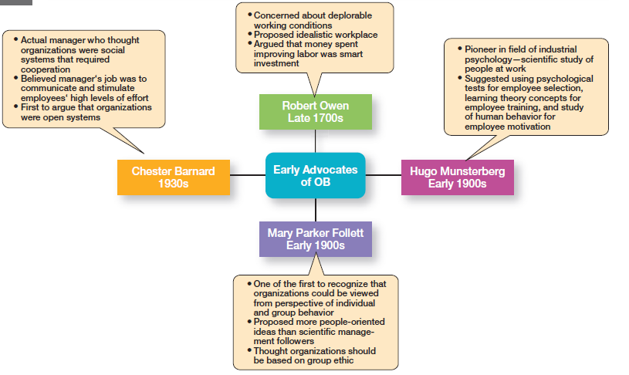
Early OB Advocates (Source: Robbins & Coutler, 2014)

Slide 31
The Hawthorne Studies
The Hawthorne Studies were the most important contribution to the development of organisational behavior.
They provided new insights into individual and group behavior.
The series of experiments conducted from 1924 to the early 1930s at the Western Electric Company Works in Cicero, Illinois,
were initially devised as a scientific management experiment to assess the impact of changes in various physical environment variables on employee productivity.
After Harvard professor Elton Mayo and his associates joined the study as consultants, other experiments were included to look at redesigning jobs, make changes in workday and workweek length, introduce rest periods, and introduce individual versus group wage plans.

Slide 32
The Hawthorne Studies
Experimental findings;
Productivity unexpectedly increased under imposed adverse working conditions.
The effect of incentive plans was less than expected.
The studies concluded that;
people’s behavior and attitudes are closely related,
that group factors significantly affect individual behavior,
that group standards establish individual worker output,
and that money is less a factor in determining output than group standards, group attitudes, and security.
These conclusions led to a new emphasis on the human behavior factor in the management of organisations.
Although not without criticism (concerning procedures, analyses of findings, and the conclusions), the Hawthorne Studies stimulated interest in human behavior in organisational settings.

Slide 33


Slide 34


Slide 35
Video Clip - The Hawthorn Effect
The Hawthorn Effect - AT & T - The Year they discovered people (13.58 mins)

Slide 36
How Do Today’s Managers Use the Behavioral Approach?
The behavioral approach assists managers in designing jobs that motivate workers, in working with employee teams, and in facilitating the flow of communication within organisations.
The behavioral approach provides the foundation for current theories of motivation, leadership, and group behavior and development.

Slide 37
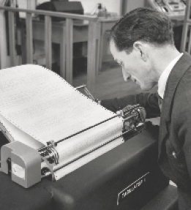
The Quantitative Approach
The quantitative approach is the use of quantitative techniques to improve managerial decision making.
Also called Operations Research or Management Science
This approach focuses on improving managerial decision making by applying statistics, optimisation models, information models, and computer simulations.
Evolved from mathematical and statistical methods developed to solve WWII military logistics and quality control problems.
After the war was over, many of these techniques used for military problems were applied to private industry.
For instance, a group of military officers – ‘the Whiz Kids’ - used quantitative methods to improve decision making at Ford Motor Company in the mid-1940s.

Slide 38
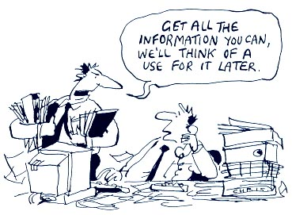
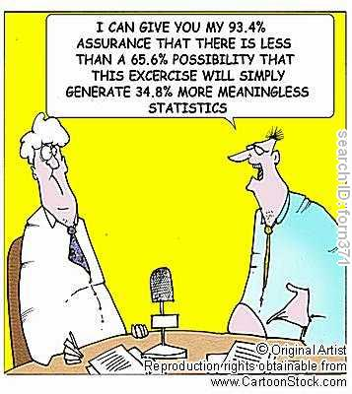
Management Use of Data!

Slide 39
How Do Today’s Managers Use the Quantitative Approach?
The quantitative approach has contributed most directly to managerial decision making, particularly in planning and controlling.
The availability of sophisticated computer software programs has made the use of quantitative techniques more feasible for managers.

Slide 40

Total Quality Management (TQM)
Quality management or TQM - a philosophy of management that is driven by continuous improvement and responsiveness to customer needs and expectations.
The term ‘customer’ includes anyone who interacts with the organisation’s product or services, internally or externally.
It encompasses employees and suppliers as well as the people who purchase the organisation’s goods or services
TQM represents a counterpoint to earlier management theorists who believed that low costs were the only road to increased productivity.
The objective of quality management is to create an organisation committed to continuous improvement in work processes.

Slide 41
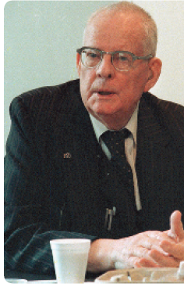
Total Quality Management (TQM)
A quality revolution swept through both the business and public sectors in the 1980’s and 1990’s.
It was inspired by a small group of quality experts; the most famous was W. Edwards Deming (pictured) and Joseph M. Juran.
The ideas and techniques they advocated in the 1950s had few supporters in the United States but were enthusiastically embraced by Japanese organisations.
As Japanese manufacturers began beating U.S. competitors in quality comparisons, however, Western managers soon took a more serious look at Deming’s and Juran’s ideas, which became the basis for today’s quality management programs.

Slide 42
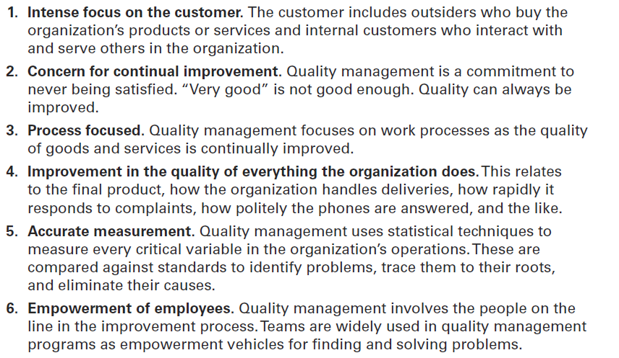
What is Quality Management?

Slide 43
Contemporary Approaches
Most of these earlier approaches focused on managers’ concerns inside the organisation.
Starting in the 1960s, management researchers began to look at what was happening in the ‘external’ environment outside the boundaries of the organisation.
Two contemporary management perspectives – ‘Systems Theory’ and ‘Contingency Theory’ - are part of this approach.

Slide 44
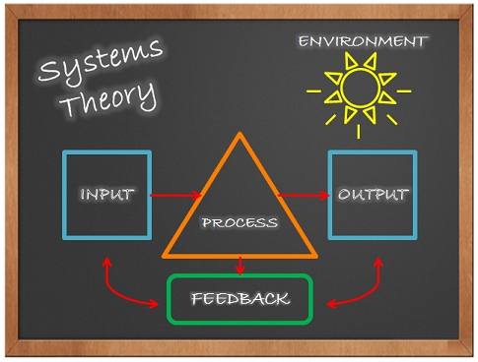

Slide 45
Contemporary Approaches: Systems Theory
Systems Theory - During the 1960s researchers began to analyse organisations from a systems perspective based on the physical sciences.
A system is a set of interrelated and interdependent parts arranged in a manner that produces a unified whole.
The two basic types of systems are ‘Closed’ and ‘Open’.

Slide 46
Contemporary Approaches: Systems Theory
Closed systems are closed off from the outside environment, and all interaction and knowledge is transmitted within the closed system only.
Closed systems can hamper growth since the flow of information stays within the system and has no chance to interact with or build on knowledge from the outer environment.
Corporate management built on a closed system is known as a "machine bureaucracy."
More prevalent among organisations, machine bureaucracies tend to hold efficiency and control as the highest goals,
They can reach these goals in various ways, including setting up a hierarchy of offices, creating rules that guide performance, separating personal and professional rights, and selecting new hires based on technical expertise alone.

Slide 47
Contemporary Approaches: Systems Theory
Examples of Closed Systems:
A production line is an example of a closed system within an organisation.
The daily work that takes place on production or assembly lines can be insulated from outside factors such as day-to-day meetings between upper-level executives, or information from other similar, competing production lines.
Instead, workers on an assembly line are generally only responsible for completing their tasks on the line, depending on what type of line it is.
Certain departments within an organisation can be set up as closed systems.
For example, a research-and-development (R&D) department within a computer organisation may be set up as a closed system with no interaction outside of the division; the purpose is to protect trade secrets and inventions that are being produced inside.

Slide 48
Contemporary Approaches: Systems Theory
An open system dynamically interact with their environment, through giving and receiving information,
e.g. a public relations department, it must interact with the outside environment on a regular basis.
Today, when we describe organisations as systems, we mean open systems.
Using the systems approach, managers envision an organisation as a body with many interdependent parts, each of which is important to the well-being of the organisation as a whole.

Slide 49
Contemporary Approaches: Systems Theory
Managers coordinate the work activities of the various parts of the organisation, realising that decisions and actions taken in one organisational area will affect other areas.
The systems approach recognises that organisations are not self-contained;
they rely on and are affected by factors in their external environment.

Slide 50
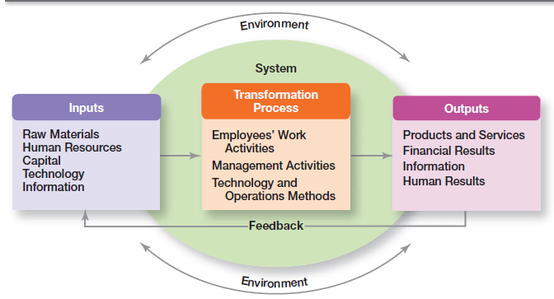
Organisation as an Open System (Source: Robbins & Coulter, 2014)

Slide 51
Contemporary Approaches: The Contingency Approach
Contingency Approach - sometimes called the Situational Approach
The contingency approach recognises that different organisations require different ways of managing.
Organisations are individually different, face different situations (contingency variables), and require different ways of managing.
There is no one universally applicable set of management principles (rules) by which to manage organisations.
Different and changing situations require managers to use different approaches and techniques as they are required.

Slide 52


Slide 53
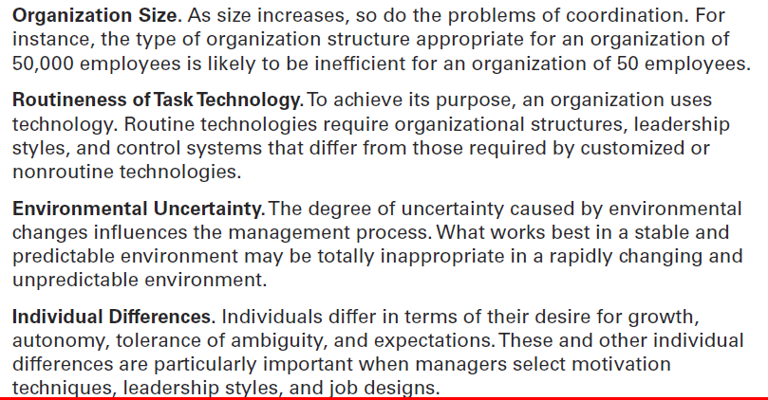
Popular Contingency Variables (Source: Robbins & Coulter, 2014)

Slide 54
